Slide 1
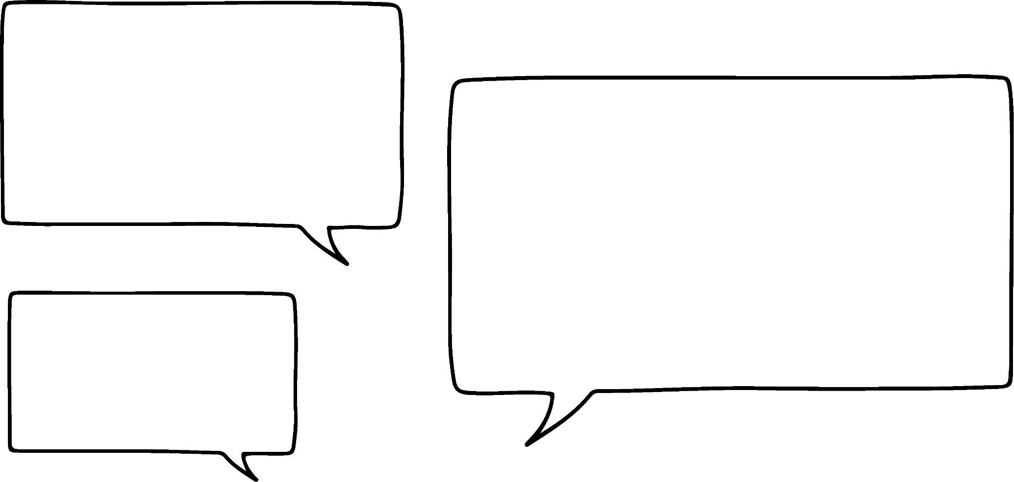




Brackets in equations
Task A: Representations of equations involving brackets
1) Write an equation and draw a bar model for Andeep and Laura’s number problems.
I am thinking of a number. When you multiply it by 5 and add 10 you get 35
I am thinking of a number. When you add 10 and multiply by 5 you get 35
x × 5 + 10 = 35
(x + 10) × 5 = 35
Andeep
5x + 10 = 35
Simplified form
5(x + 10) = 35
Laura
x
x
x
x
x
10
x
10
x
10
x
10
x
10
x
10
35
35
2) Write equations for the bar models that Jun and Jacob have drawn. If you can see more than one way to write the equation you should do so.
y
5
y
5
y
5
y
3
y
3
y
3
y
3
y
3
30
30
(y + 5) × 3 = 30
(y + 3) × 5 = 30
3(y + 5) = 30
5(y + 3) = 30
Jun
3 × y + 3 × 5 = 30
5 × y + 5 × 3 = 30
Jacob
3y + 15 = 30
5y + 15 = 30

Slide 2
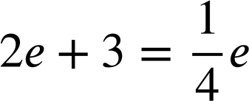
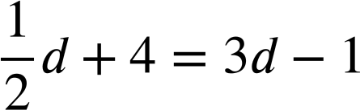
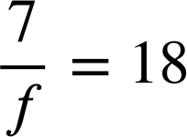
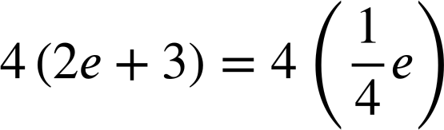
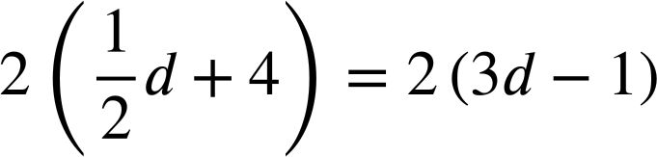
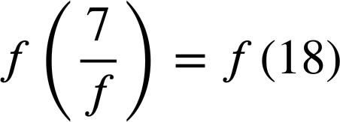
Brackets in equations
Task B: Effectively using brackets in equations
1) Spot the errors in these manipulations of equations.
Once spotted, write a sentence to explain each error.
a)
y + 3 = 4y + 6
b)
y + 3 = 4y − 6
c)
y + 3 = 4y + 6
4(y + 3) = 4y + 6
2(y + 3) = 2(4y − 6)
4(y + 3) = 2(4y + 6)
4y + 12 = 4y + 6
2y + 3 = 8y − 6
4y + 12 = 8y + 12
The multiplication only occurred on one side of the equation.
All terms inside the bracket need to be multiplied.
Both sides need to be multiplied by the same term.
2) Fill in the missing parts of these manipulations of equations.
a)
b)
c)
8e + 12 = e
d + 8 = 6d − 2
7 = 18f
Mathematics in Education and Industry.
v2.3

